Slide 1

Chapter 7:Development Strategies
Version 2 – 18th December 2015

Slide 2
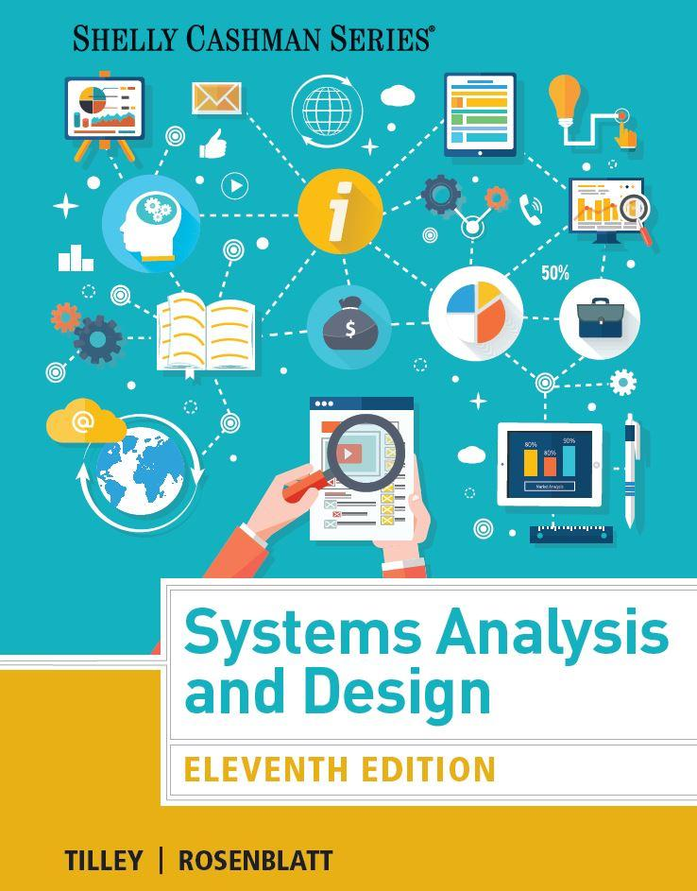
Prescribed Text and recommended readings
Rosenblatt, H. J. (2016), Systems Analysis and Design.11th Edition, Cengage Learning, Boston MA
Robertson, S. and Robertson, J. (2013), Mastering the Requirements Process: Getting Requirements Right, 3rd Edition, Addison Wesley, Upper Saddle River, NJ
IIBA (2015), Guide to the Business Analysis Body of Knowledge, BABOK Version 3.0, International Institute of Business Analysis, http://www.iiba.org/BABOKGuide.aspx

Slide 3
Learning Objectives
Describe the concept of Software as a Service
Define Web 2.0 and cloud computing
Explain software acquisition alternatives, including traditional and Web-based software development strategies
Describe software outsourcing options, including offshore outsourcing and the role of service providers

Slide 4
Learning Objectives
Explain advantages and disadvantages of in-house software development
Discuss cost-benefit analysis and financial analysis tools
Describe a request for proposal (RFP) and a request for quotation (RFQ)
Describe the system requirements document
Explain the transition from systems analysis to systems design

Slide 5
Development Strategies Overview
Earlier, certain work functions in the company required:
Development of software by in-house efforts
Employing the services of external entities
Today, organizations have following choices for software acquisition
Application service providers
Web-hosted software options
Firms that offer enterprise-wide software solutions
Selecting the best development path is an important decision
Notes:
Today

Slide 6
The Impact of the Internet
Software as a Service (SaaS)
Software deployment model that hosts an application as a service provided to customers over the Internet
Reduces the customer’s need for software maintenance, operation, and support

Slide 7
The Impact of the Internet (Cont.1)
Traditional vs. Web-Based Systems Development
Service-oriented architecture (SOA)
A way of engineering systems in which reusable business functionality is provided by services through well-defined interfaces
Technically, not software architecture but an architectural style

Slide 8
The Impact of the Internet (Cont.2)
Traditional vs. Web-Based Systems Development
Traditional Development
System design is influenced by compatibility issues
Systems are designed to run on local and wide-area networks
Systems often utilize Internet links and resources
Development typically follows one of three main paths:
In-house development
Purchase of a software package with possible modification
Use of outside consultants
Scalability is affected by network limitations and constraints

Slide 9
The Impact of the Internet (Cont.3)
Traditional vs. Web-Based Systems Development (Cont.)
Web-Based Development
Systems are developed and delivered on an Internet-based framework
Treats the Web as the platform rather than just a communication channel
Web-based systems are easily scalable and can run on multiple hardware environments
Used for customer relationship management, order processing, and materials management
Treats software applications as services that are less dependent on desktop computing power and resources

Slide 10
The Impact of the Internet (Cont.4)
Traditional vs. Web-Based Systems Development (Cont.)
Web-Based Development
Requires additional layers, called middleware, to communicate with existing software and legacy systems
Middleware: Connects dissimilar applications and enables them to communicate and exchange data
Open more complex security issues that should be addressed

Slide 11
The Impact of the Internet (Cont.5)
Evolving Trends - Web 2.0, Cloud Computing, and Mobile Devices
Web 2.0: second generation of the web that enables people to collaborate, interact, and share information much more effectively
Enhances interactive experiences
Cloud computing: Online software in which applications and services are accessed and used through an Internet connection
Mobile devices: Smartphones, tablets, and other computing devices that are not permanently tethered to a desk

Slide 12
Outsourcing
Transfer of information systems development, operation, or maintenance to an outside firm
The Growth of Outsourcing
Service provider: Offers outsourcing solutions Application service provider (ASP)
Delivers a software application or access to an application by charging a usage or subscription fee
Internet business services (IBS)
Also called managed hosting
Provide web-based support for transactions

Slide 13
Outsourcing (Cont.1)
Outsourcing Fees
Fixed fee model: Uses a set fee based on a specified level of service and user support
Subscription model: Has a variable fee based on the number of users or workstations that have access to the application
Usage model or transaction model: Charges a variable fee based on the volume of transactions or operations performed by the application

Slide 14
Outsourcing (Cont.2)
Outsourcing Issues and Concerns
Mission-critical IT systems are outsourced if the result is a cost-attractive and reliable business solution
Overseas outsourcing can raise issues with control, culture communication, and security
Reviewing the outsourcing firm’s history and financial condition is vital
Outsourcing clients can be affected by mergers and acquisitions
Employee job security is a major concern

Slide 15
Outsourcing (Cont.3)
Offshore Outsourcing
Called global outsourcing
Shifting IT development, support, and operations to other countries
Reason - Lower bottom-line costs
Risks and concerns
Impact on the economy
Project control
Security issues

Slide 16
In-House Software Development Options
Software development options
Develop own systems
Purchase, possibly customize, and implement a software package
Most important consideration is the total cost of ownership (TCO)
Companies can develop user applications based on commercial software packages

Slide 17
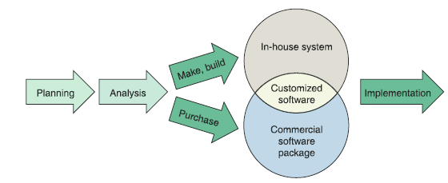
In-House Software Development Options (Cont.1)
Make or Buy Decision
Refers to the choice between developing and purchasing
A company’s IT department makes, builds, and develops in-house software
A software package is obtained from a vendor or application service provider
FIGURE 7-8 Instead of outsourcing, a company can choose to develop a system in-house, or purchase and possibly customize a commercial package.

Slide 18
In-House Software Development Options (Cont.2)
Make or Buy Decision (cont.)
Software package: Obtained from a vendor or application service provider
Software vendors: Develop software for sale
Value-added reseller (VAR): Enhances a commercial package by adding custom features and configuring it for a particular industry
Horizontal application: Can be used by many different types of organizations
Vertical application: Developed to handle information requirements for a specific type of business

Slide 19
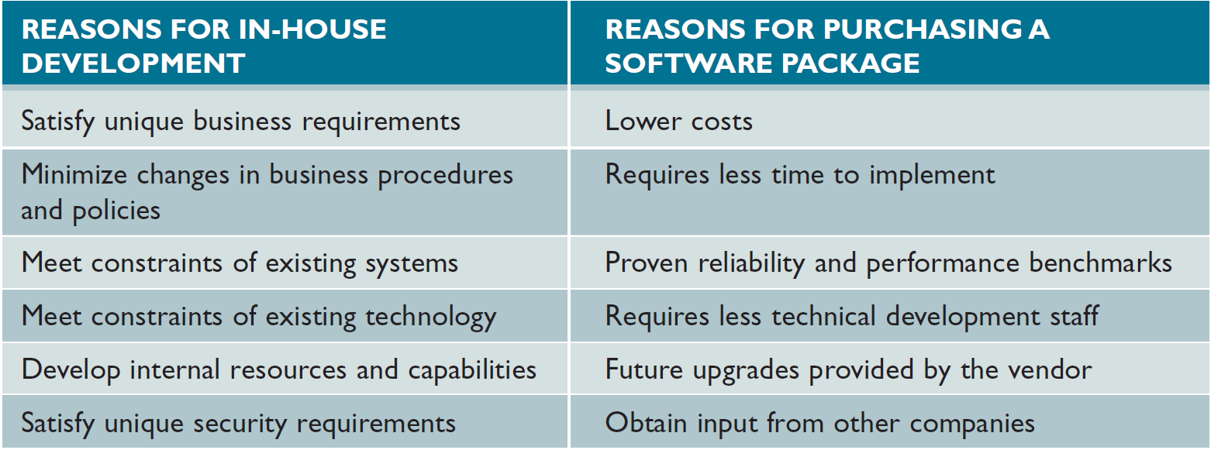
In-House Software Development Options (Cont.3)
FIGURE 7-10 Companies consider various factors when comparing in-house development with the purchase of a software package.

Slide 20
In-House Software Development Options (Cont.4)
Developing Software In-House
Satisfies unique business requirements
Not possible with standard commercial software packages
Minimizes changes in business procedures and policies
Installing a new software package almost always requires some degree of change in how a company does business
Meets constraints of existing systems
Any new software installed must work with existing systems

Slide 21
In-House Software Development Options (Cont.5)
Developing Software In-House (Cont.)
Meets constraints of existing technology
The new system must work with existing hardware and legacy systems
Develops internal resources and capabilities
Companies can develop and train IT staff who understand the organization’s business functions and information support needs

Slide 22
In-House Software Development Options (Cont.6)
Purchasing a Software Package
Lower costs
A software package is less expensive than the one developed in-house
Requires less time to implement
Packages have already been designed, programmed, tested, and documented
Proven reliability and performance benchmarks
Major problems would have been detected and corrected by the vendor

Slide 23
In-House Software Development Options (Cont.7)
Purchasing a Software Package (Cont.)
Requires less technical development staff
Companies can reduce the number of programmers and systems analysts on the IT staff
Future upgrades provided by the vendor
Improvements and enhancements are included in regular updates
Input from other companies
Users in other companies can be contacted to obtain their input and opinions

Slide 24
In-House Software Development Options (Cont.8)
Customizing a Software Package
Purchase a basic package that vendors will customize to suit project requirements
Negotiate directly with the software vendor to make enhancements to meet project needs by paying for the changes
Purchase the package and make project-specific modifications
Ensure modifications are permissible under the terms of the software license

Slide 25
In-House Software Development Options (Cont.9)
Creating User Applications
User application: Utilizes standard business software
User interface: Enables effective interaction with the application
Service desk or information center (IC): Provides user support
Screen generators and report generators: Allow users to design their own data entry forms and reports
Appropriate controls must be provided to ensure data security and integrity

Slide 26
In-House Software Development Options (Cont.10)
Figure 7-11 Microsoft Access includes Form Wizard and a Report Wizard tools that ask a series of questions and then create the form or report.
Source: Screenshots used with permission from Microsoft

Slide 27
The Systems Analyst’s Role
Based on decisions taken by the organization in the systems development process
Current and future needs are considered
Evaluation and selection of alternatives is a complicated process
Forecasting actual costs is difficult
Evaluation and selection team: Selects hardware and software, includes systems analysts and users
Ensures that critical factors are not overlooked and that a sound choice is made

Slide 28
Analyzing Cost and Benefits
Financial Analysis Tools
Payback analysis
Determines the time taken for an information system to pay for itself through reduced costs and increased benefits
Return on investment (ROI)
Percentage rate that compares the total net benefits (the return) received from a project to the total costs (the investment) of the project
Net present value (NPV)
Total value of the benefits minus the total value of the costs

Slide 29
Analyzing Cost and Benefits (Cont. 1)
Figure 7-12 In this example, the HP interactive TCO calculator is used to determine the ROI of migrating to an Infrastructure-as-a-Service (IaaS) environment in the cloud from a traditional server environment
Source: Hewlett-Packard Development Company, L.P.

Slide 30
Analyzing Cost and Benefits(Cont. 2)
Cost-Benefit Analysis Checklist
List each development strategy being considered
Identify all costs and benefits for each alternative
Consider future growth and the need for scalability
Include support costs for hardware and software
Analyze various software licensing options
Apply the financial analysis tools to each alternative
Study the results and prepare a report

Slide 31
The Software Acquisition Process
Step 1 - Evaluate the Information System Requirements
Identify key features
Consider network and Web-related issues
Estimate volume and future growth
Specify hardware, software, or personnel constraints
Prepare a request for proposal or quotation
Request for proposal (RFP): Describes the company, lists the IT services or products needed, and specifies the features required
Request for quotation (RFQ): more specific than an RFP

Slide 32
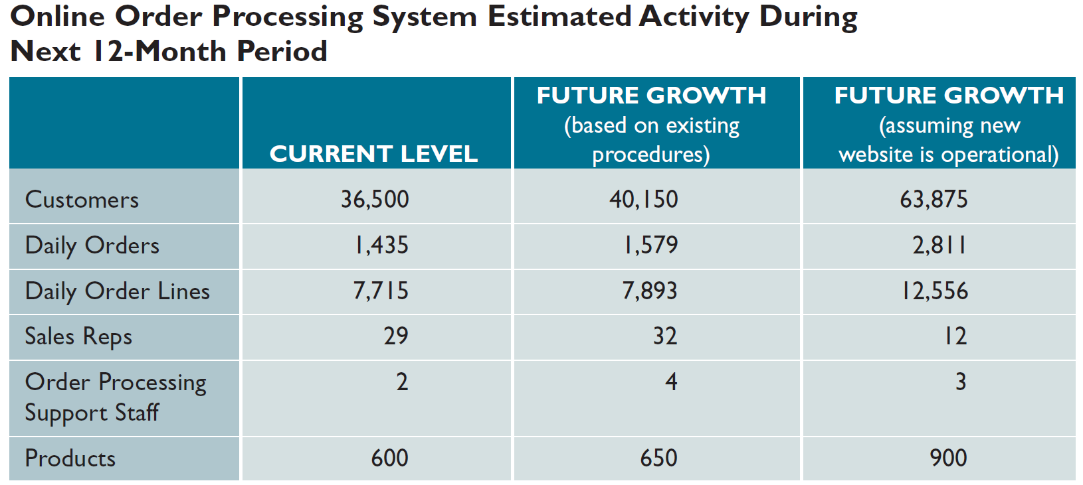
The Software Acquisition Process (Cont.1)
FIGURE 7-13 Volume estimates for an order processing system showing current activity levels and two forecasts: one based on the existing order processing procedures and another that assumes a new Web site is operational.

Slide 33
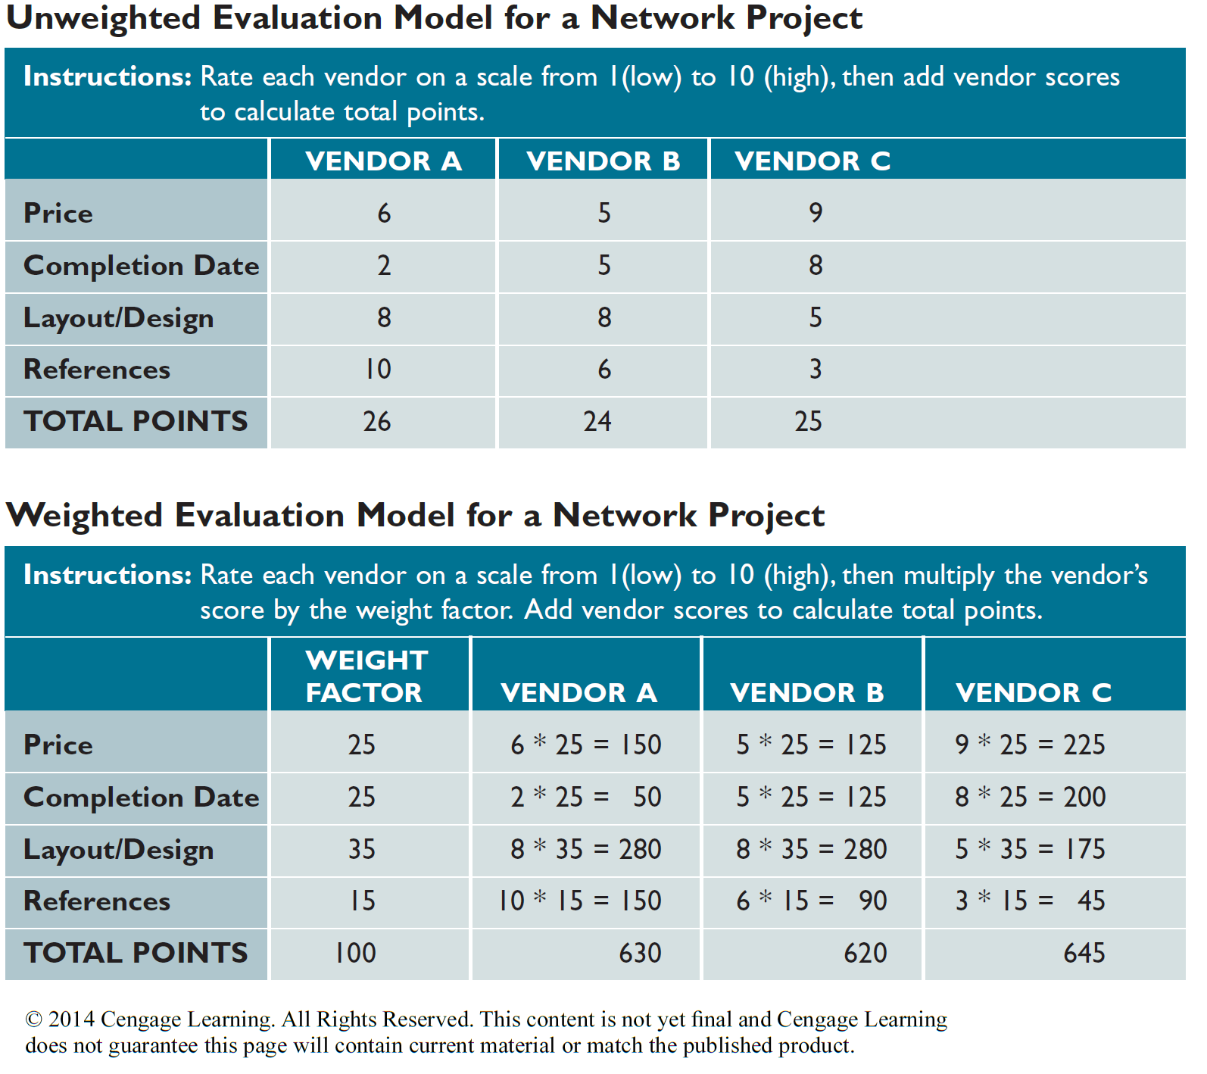
The Software Acquisition Process (Cont.2)
FIGURE 7-15 The three vendors have the same initial ratings, but the two evaluation models produce different results. In the unweighted model at the top of the figure, vendor A has the highest total points. However, after applying weight factors, vendor C is the winner, as shown in the model at the bottom of the figure.

Slide 34
The Software Acquisition Process (Cont.3)
Step 2 - Identify Potential Vendors or Outsourcing Options
The Internet contains information on all major products and acquisition services
The organization can avail the services of a consulting firm that help companies select software packages
Online forums or newsgroups provide opinions and ideas
Google Groups
Yahoo Groups

Slide 35
The Software Acquisition Process (Cont.4)
Step 3 - Evaluate the Alternatives
Existing users
Provide feedback about their experiences
Application testing
Users in the organization may be able to test the product
Benchmarking
Benchmark: Measures the time a package takes to process a certain number of transactions
Each package is matched against RFP features and the choices are ranked

Slide 36
The Software Acquisition Process (Cont.5)
Step 4 - Perform Cost-Benefit Analysis
Identify and calculate total cost of ownership (TCO) for each option being considered
Study the conditions of use that come along with the software license
If a software package is purchased, consider a supplemental maintenance agreement

Slide 37
The Software Acquisition Process (Cont.6)
Step 5 - Prepare a Recommendation
Evaluate and describe alternatives along with:
Costs
Benefits
Advantages
Disadvantages
Submit a formal system requirements document and deliver a presentation

Slide 38
The Software Acquisition Process (Cont.7)
Step 6 - Implement the Solution
Implementation tasks will depend on the solution selected
Before the new software becomes operational, complete all implementation steps
Loading
Configuring and testing the software
Training users
Converting data files to the new system’s format

Slide 39
Completion of Systems Analysis Tasks
System Requirements Document
Called software requirements specification
Contains the requirements for the new system
Describes the alternatives considered
Makes a specific recommendation to management
Similar to a contract
Identifies items that system developers must deliver to users
Format and organize the systems document
Easy to read and use

Slide 40
Completion of Systems Analysis Tasks (Cont.1)
Presentation to Management
Helps take key decisions that affect the future development of the system
Suggestions for effective presentations
Start with a brief overview
Summarize the primary viable alternatives
Explain why the evaluation and selection team chose the recommended alternative
Allow time for discussion
Obtain a final decision from management or agree on a timetable for the next step in the process

Slide 41
Completion of Systems Analysis Tasks (Cont.2)
Presentation to Management (Cont.)
Depending on management’s decision, a systems analyst will do one of the following
Implement an outsourcing alternative
Develop an in-house system
Purchase or customize a software package
Perform additional systems analysis work
Stop all further work
Post presentation and management decision, the project begins a transition to the systems phase of the SDLC

Slide 42
Transition to System Design
Preparing for Systems Design
Systems design requires accurate documentation
Provide detailed specifications for output, input, data, processes, and other requirements
Logical and Physical Design
Logical design: Defines what must take place
Physical design: Describes the actual process of entering, verifying, and storing data
Logical and physical designs are closely related
Accurate systems analysis is required

Slide 43
Chapter Summary
A new trend views Software as a Service (SaaS), rather than a product
Traditional systems must:
Function in various hardware and software environments
Be compatible with legacy systems
Operate within the constraints of company networks and desktop computing capability
Companies that choose to handle their own software development needs can:
Create in-house systems
Commercially purchase software packages

Slide 44
Chapter Summary (Cont. 1)
The systems analyst’s role in the software development process depends on the specific development strategy
The most important factor in choosing a development strategy is total cost of ownership (TCO)
Financial analysis tools include:
Payback analysis
Return on investment (ROI)
Net present value (NPV)

Slide 45
Chapter Summary (Cont.2)
Acquiring software involves a series of specific steps
The system requirements document is the deliverable, or end product, of the systems analysis phase

Slide 46

kent.edu.au Kent Institute Australia Pty. Ltd. ABN 49 003 577 302 ● CRICOS Code: 00161E ● RTO Code: 90458 ● TEQSA Provider Number: PRV12051

